Slide 1
The Battle of Neighborhoods
Recommending the best location to open a new cafe in New York City

Slide 2
Business Problem
A client wants to open a cool new cafe in New York City.
Since the city has a lot of fast food chains and famous cafes, she is looking for a neighborhood where there are not many famous coffee places - a neighborhood where many people would come to her café and explore.
We need to provide her the best location through which she could make the most profit.

Slide 3
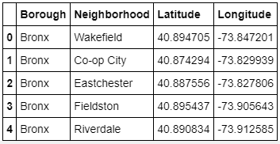
Data
We will use the location data for New York City from a GeoJSON file from https://cocl.us/new_york_dataset.
Only the Borough, Neighborhoods, Latitude and Longitude is then filtered out from the json and a new dataframe is created.

Slide 4
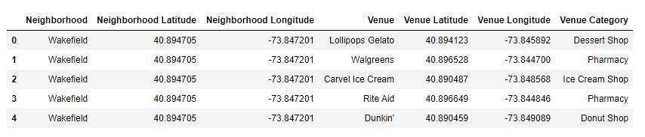
Data
We will then be using data from the Foursquare API to explore the neighborhoods.
We shall use the explore endpoint for the API calls to obtain the venues near each neighborhood of New York City, with the url https://api.foursquare.com/v2/venues/explore . The response received as a json file is then cleaned and formatted into the following dataframe.

Slide 5
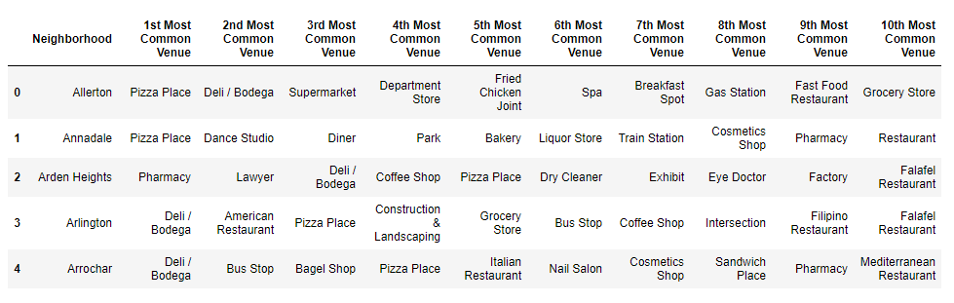
Data
For further analysis, we convert the data into a dataframe denoting the categories of 10 most common venues in each of the 301 neighborhoods.
This data is used for clustering the neighborhoods, by which we could arrive at a solution to our problem, i.e., the right place to open the cafe.

Slide 6
Methodology
We have collected the New York location data and have explored the most common venues in each Neighborhood with the help of Foursquare API.
We now have our data as required, with the ten most common venues in each neighborhood of New York. We can now use this data for further analysis using Machine Learning techniques and arrive at a solution.

Slide 7
Methodology
We will use the k-means clustering algorithm to cluster the neighborhoods based on the types of venues that exist in the vicinity.
By applying the algorithm on our dataset and then analyzing the resultant clusters, we would be able to make our recommendations to our client.

Slide 8
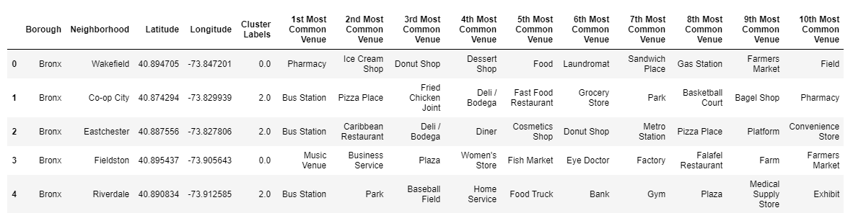
Results and Discussion
Using k-means clustering, 5 clusters are created based on the ten most common venues of each neighborhood.
The Cluster Labels column denotes the cluster the neighbourhood belongs to.

Slide 9
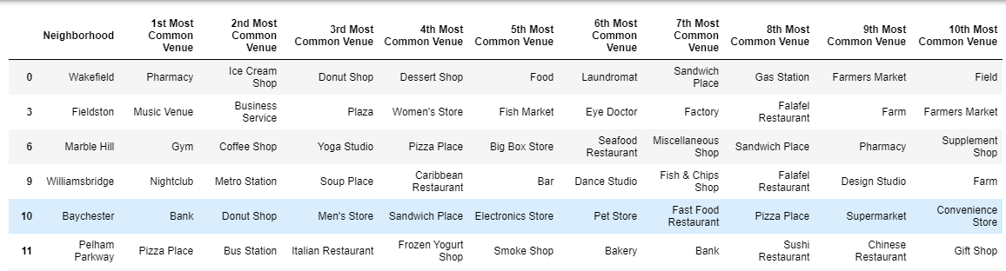
Results and Discussion
Cluster 1 (displaying only top 5 rows as the resultant dataframe is too large)
Cluster 2

Slide 10
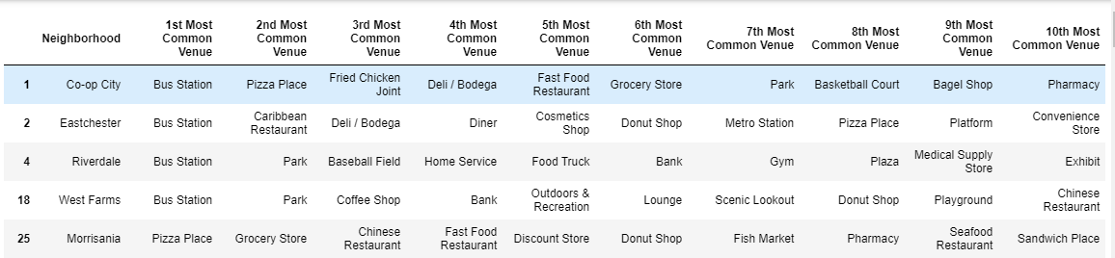
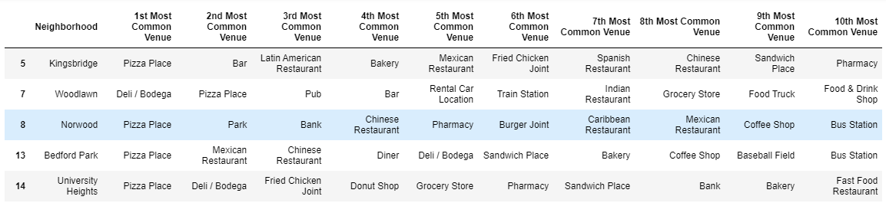
Results and Discussion
Cluster 3 (displaying only top 5 rows as the resultant dataframe is too large)
Cluster 4 (displaying only top 5 rows as the resultant dataframe is too large)

Slide 11
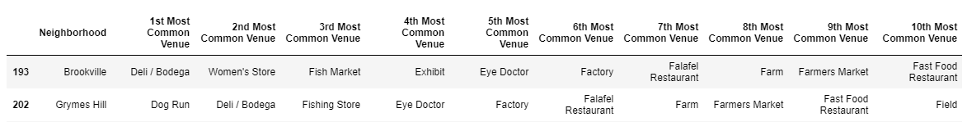
Results and Discussion
Cluster 5
From the above analysis, it is clear that the neighborhoods in clusters 1, 3 and 4 are busy streets with a lot of famous eateries and restaurants. They are already filled with bars, fast food restaurants, dessert places, pizza places, cafes and what not. There is a lot of competition and it would be not that easy to make a famous name if a new café is opened here.

Slide 12
Results and Discussion
Clusters 2 and 5 do not have many famous options.
Cluster 2 has parks, women’s stores, grocery stores, etc and Cluster 5 has farms, eye doctors, factories, dog-run places, etc. People do come here frequently for regular eye check-ups or to run their dogs or women for some pampering. There might also be people working in the factories or farms who daily come to the neighborhood.
As there are no famous eateries or cafes here. If a new café is launched here, it would be great as there are too many people who come to the neighborhood regularly and would want to grab a cup of coffee.

Slide 13
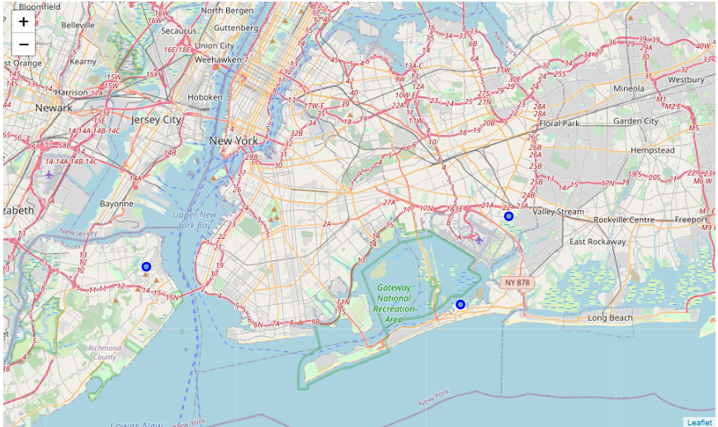
Results and Discussion
It is recommended to open a cafe in the neighborhoods of the clusters 2 and 5 –
Brookville, Grymes Hill or Somerville.

Slide 14
Conclusion
In this study, the neighborhoods of New York City are explored.
The most famous venues in each neighborhood are identified and the neighborhoods are grouped into various clusters. On further analysis of the clusters, we have understood the types of places that are famous in a given neighborhood.
Hence, our client is recommended to open her new café in the lesser popular neighborhoods - Brookville, Grymes Hill or Somerville.
The analysis can be extended further to recommend a location for any type of venues to be opened throughout New York City.

